Slide 1
Pbee, a virtual assistant
Policybazaar chat support
Github: https://github.com/jerinjohnk/pb-hackathon2021

Slide 2

Dialogflow as base
Small talk
Avatar
Prebuilt small talk modules
Integrated into different model
Handoff
Cellular Call
From agent to human.
30 days availability
Sentimental
React Native
Analysis used to identify intent
Dialogflow across web and react native

Slide 3
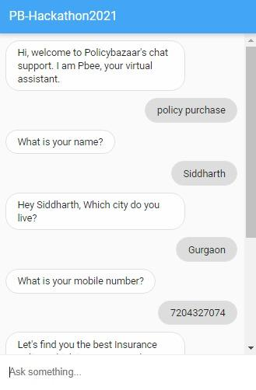
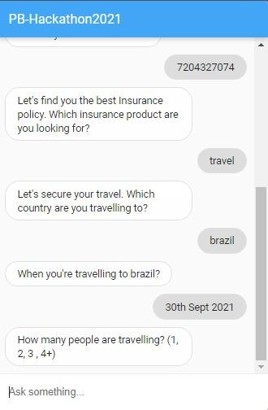
Dialogflow training
Feeding data to AI
We are training the AI for different insurance policies.
And test it in Dialogflow messenger before the final integration.
Notes:
Cellular Call Handoff
1) Created Gmail and other JSS account
2) 11:00 Initial setup with small talk basic dialogflow
3) 16:00 Initial handoff, voice call, avatar
4) https://creator.us.uneeq.io/try/2d10c753-de50-47f9-8728-9d52ebf06d58

Slide 4
Mobile Application
react-native-gifted-chat
react-native-tts
Provides the chat UI for react native and web
03
04
Future iteration for chat support
react-native-voice
02
05
Sentimental Analysis
Interdependency for react-native-dialogflow
Integration of nlp,
Text analysis
react-native-dialogflow
01
06
Suggestion
Core library used for integration of dialogflow
Any suggestion for
further enhancement?

Slide 5
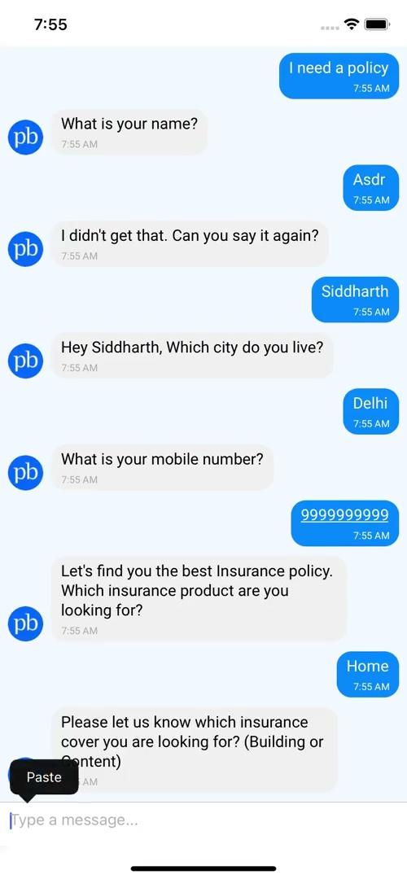
Mobile Application Demo
Chatbot
25%
35%
Working chatbot prototype made with the integration of Dialogflow and react-native
10%
40%

Slide 6


Difficulties we faced…
Tenserflow
Handoff
Tenserflow integration with react-native
Training AI to understand user behaviour
Time Limit
Dialogflow
Short of time and lot of R&D’s
Dialogflow integration with backend

Slide 7
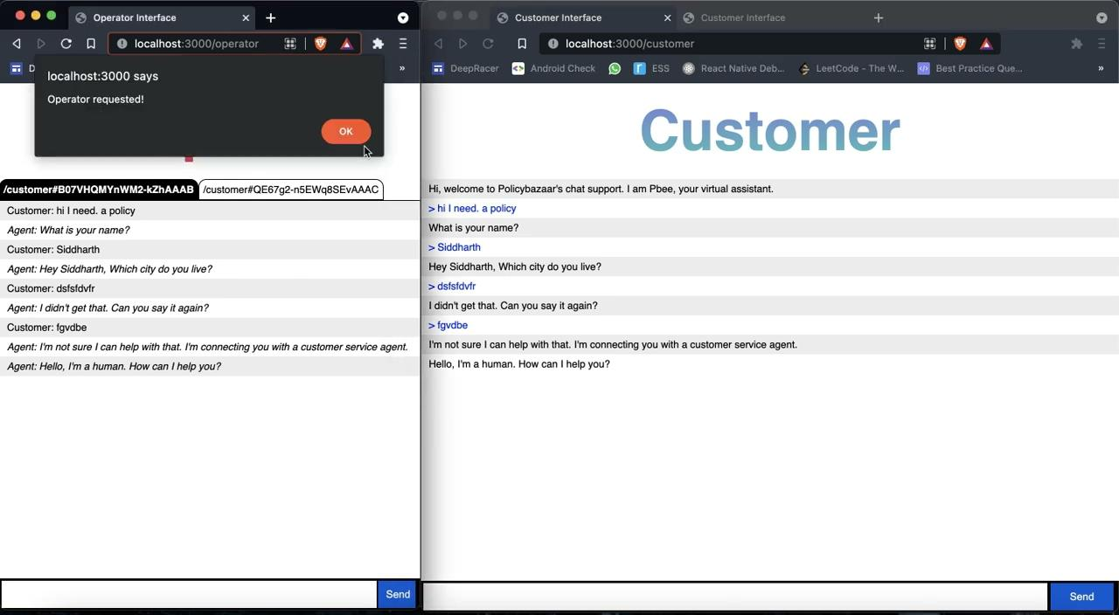
Handoff
Based on https://github.com/dialogflow/agent-human-handoff-nodejs Exploring agent handoff to human
Initial Integration

Slide 8
Tasks that can be accomplished...
Rich Messages
Eg: Suggestion chips
Combining Intents
User can reach quotes without even logging to app

Slide 9
Pbee Virtual Assistant
Chat
Future iteration
User chat service
Buy and sell insurance based on LeadId
Call
NLP
Scope
Pbee is also available on call
Ml based text classification
Studies suggest 50% of knowledge workers will use a virtual assistant by 2025

Slide 10
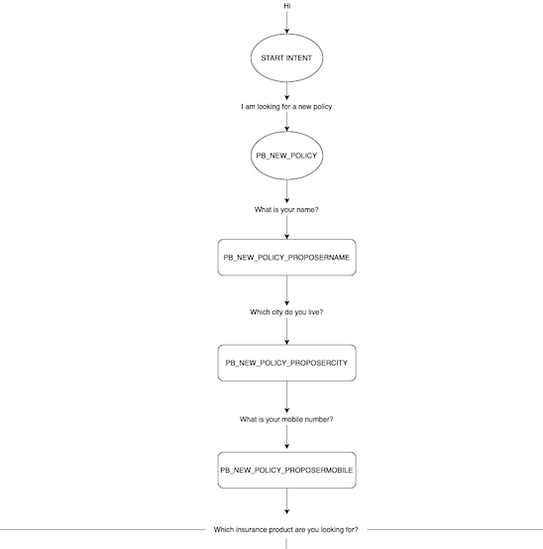
Virtual Assistant flowchart

Slide 11
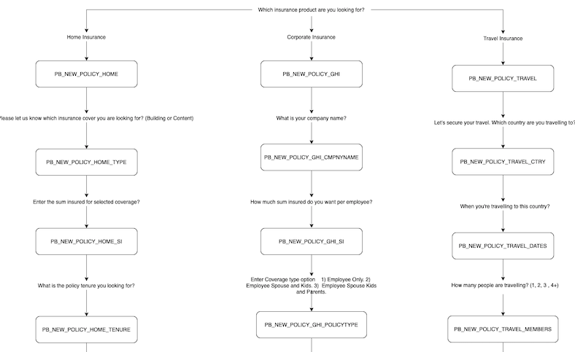
Virtual Assistant flowchart

Slide 12
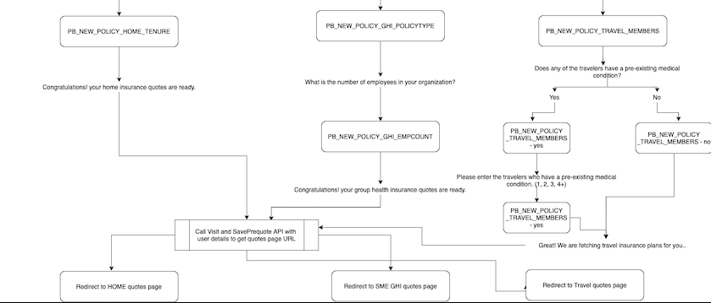
Virtual Assistant flowchart

Slide 13
Mobile Application youtube links
Corporate Insurance Flow
https://youtu.be/uJOBFVPR0nw
Agent Handoff
https://youtu.be/FdzaV9x4L4Y
Travel Insurance Flow
https://youtu.be/c1GI_4VkmnI
React Native Integration
https://youtu.be/m8drOSXXi6Y
Playlist
https://bit.ly/jss-pbee-playlist
Home Insurance Flow
https://youtu.be/l_j5WBH8ux0

Slide 14

Pbee Assistant Voice Call Demo

Slide 15
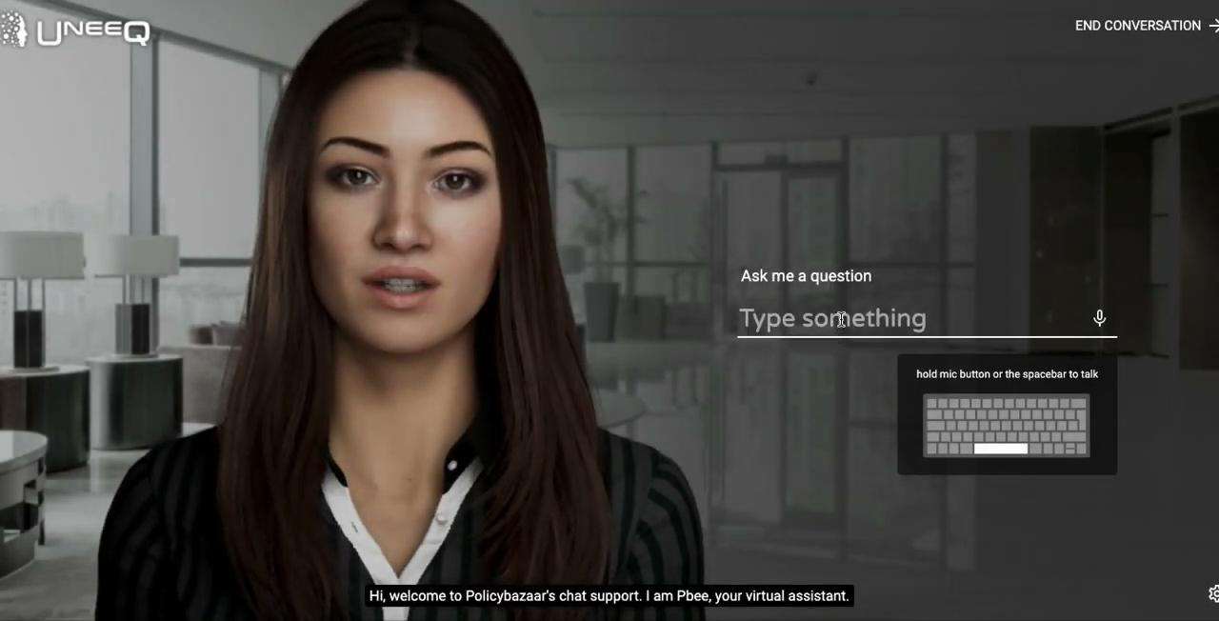
Pbee Assistant Home Insurance Demo

